Slide 1
America’s Great Disasters
Mr. Ryan

Slide 2
Great Disasters
Many terrible things have happened to America and her citizens
Floods, Hurricanes, Fires, Blizzards, Explosions, Diseases
Causes death, injuries, loss of homes, money, jobs, communities, friendships
But many good things arise too! Safety laws, sense of community & accomplishment, new inventions/technology

Slide 3
Sultana Explosion
Largest maritime disaster
April 1865 on the Mississippi River near Memphis TN
Civil War POW’s were crammed onto the 260 ft. steamboat Sultana to go to the North for their freedom at the end of the war
Ship meant to hold 376 passengers

Slide 4
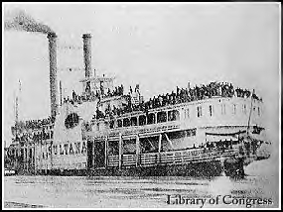
USS Sultana

Slide 5
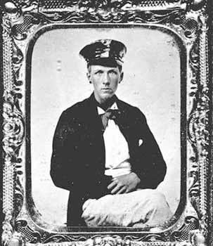
Sultana
Govt. paid $5.00 per person, so Captain Mason put almost 3000 people plus animals and cargo on boat
Boilers exploded killing many and setting the ship on fire
Because of poor records, nobody knows how many died: estimate 2300-3000
Not famous because the Civil War just ended and President Lincoln was killed too!
Captain Mason

Slide 6
The General Slocum Disaster
Steamboat out of NYC on June 15, 1904 for a church picnic on the East River
Over 1300 on board, ship meant to hold less than ½ of that
Teen saw the fire and told the captain, but was ignored
1031 people died, mostly children

Slide 7
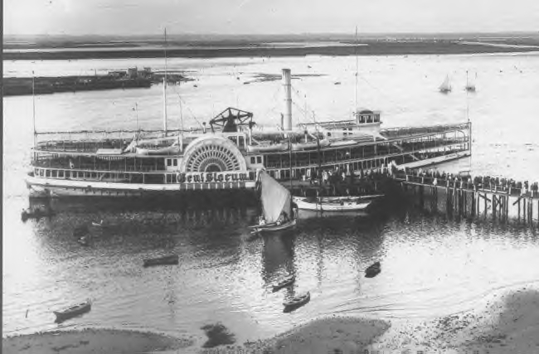
The General Slocum

Slide 8
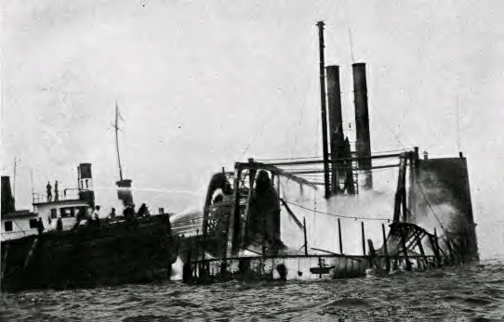
The General Slocum

Slide 9
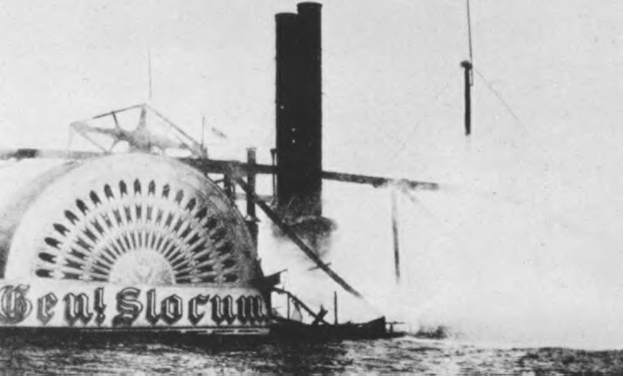
The General Slocum
Because the life boats were wired together too tightly and the life vests were too heavy…many died. This created an uproar and many new laws were passed to make sure it doesn’t happen again.

Slide 10
The Great Johnstown Flood
May 30, 1889 Johnstown PA
Johnstown, East Conemaugh, and Woodvale lived “downhill” of Lake Conemaugh, which had a dam built about 1850
The dam was 1000 feet long. The lake was 500 acres and held 25 million tons of water
The lake wasn’t needed anymore to supply water to the canal because of the railroad built in 1854

Slide 11
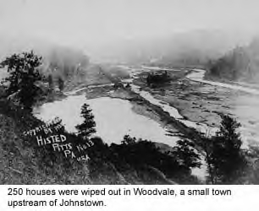
The Great Johnstown Flood
On May 30, with over 8 inches of rain that day, the dam broke and the wall of water
Raced downhill and destroyed 3 entire towns and killing over 2000.

Slide 12
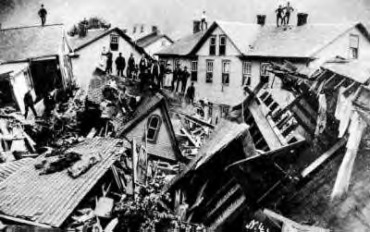
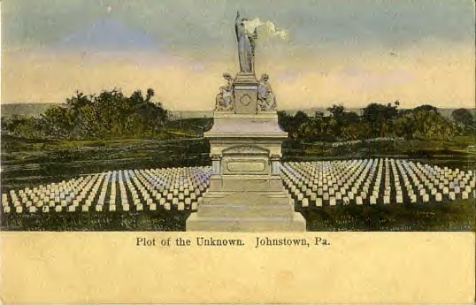
The Great Johnstown Flood
Over 2000 people died in this Mill town

Slide 13
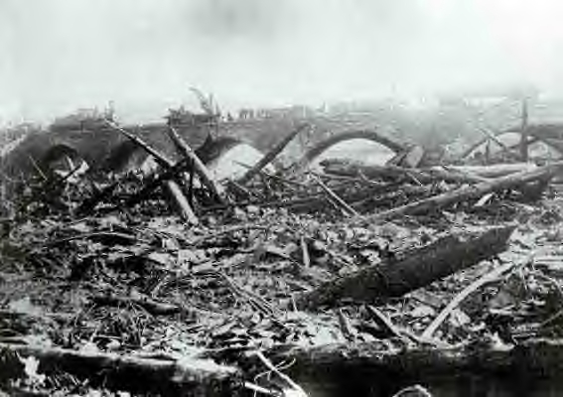
The Great Johnstown Flood
Ironically, the railroad bridge was one of the few structures that with stood the
disaster. Sorry to say, all the houses and trees that got stuck against the bridge
caught on fire and killed all those standing on the bridge for safety. Because of
this disaster, all dams must now be inspected by the government.

Slide 14
The Great Drought
During the 1930’s (The Depression), there was little to no rain in the Mid-West
With no rain, trees (wind breaks) and over farming, the topsoil “blew away”
The Midwest was known as the Great Dustbowl
It forced many farmers to lose their farms and move to find work

Slide 15
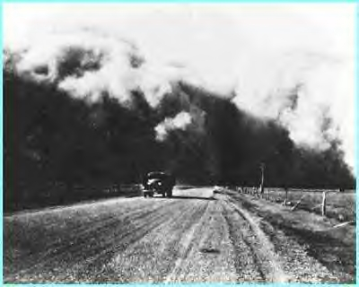
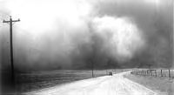
The Great Drought
The Dust Storms caused by the
prairie wind and drought.

Slide 16
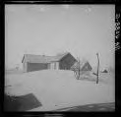
The Great Drought
There was dust “everywhere” inside and outside, in your eyes, and in your mouth. Many died from Dust Pneumonia
Farmers were then taught how to conserve water, plant wind breaks and how not to destroy the top soil by planting different kinds of plants that help put nutrients into the soil

Slide 17
Galveston Hurricane
September 8, 1900
Winds were up to 150 miles per hour
Storm surge of over 16 feet
Over 6,000 people killed on Galveston Island
Another 6,000 were killed in Texas
Worst Hurricane ever to hit the USA

Slide 18
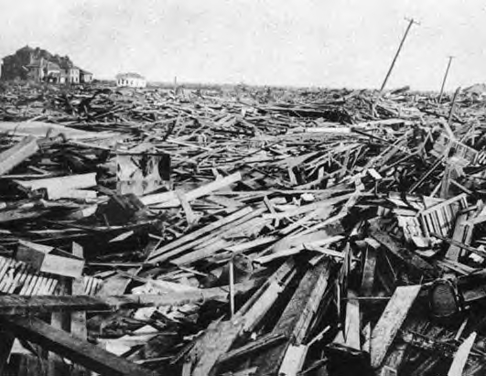
Galveston Hurricane

Slide 19
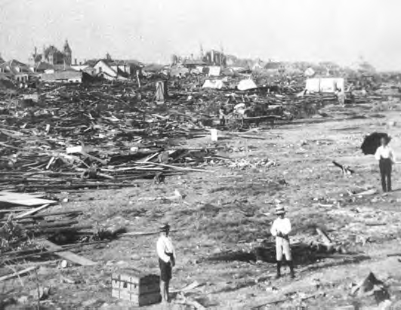
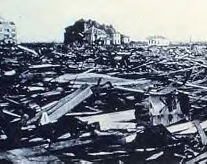
Galveston Hurricane

Slide 20
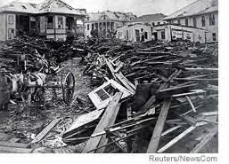
Galveston Hurricane
Now the city has a sea wall, better building codes and is actually
raised up the entire city by putting sand under buildings!

Slide 21
Blizzard of 1888
March 11, 1888
New England states were pounded with freezing temperatures, 70 mph winds and massive amounts of snow
Snow Drifts over 30 feet high
Still snow in JULY!!!
Destroyed telegraph, telephone, electric poles and stopped all trains (including food and coal trains)

Slide 22
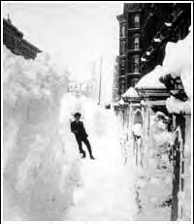
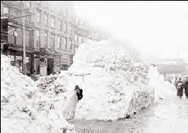
Blizzard of 1888

Slide 23
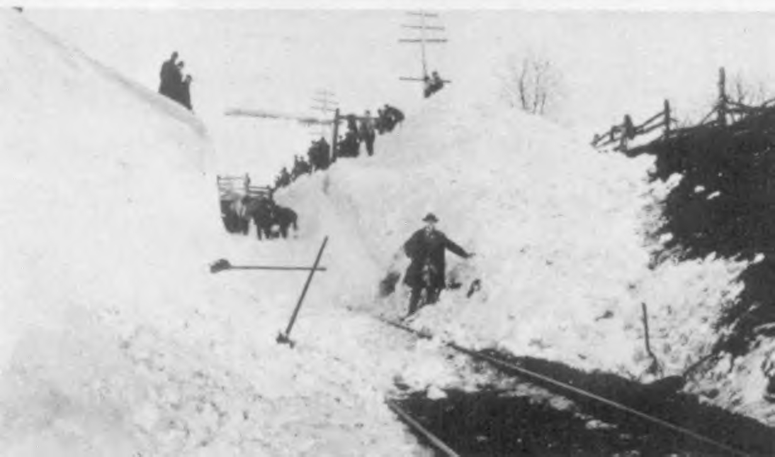
Blizzard of 1888
You had to shovel out the
Street!!
Because of the Blizzard, NYC and many
other cities put electric and telephone
cables underground. They also built
the subway underground too!

Slide 24
Influenza Pandemic of 1918
This “flu” killed 23 million world wide…500,000 in the United States
Avian flu (today) is similar to 1918, but it does pass human to human like it did in 1918

Slide 25
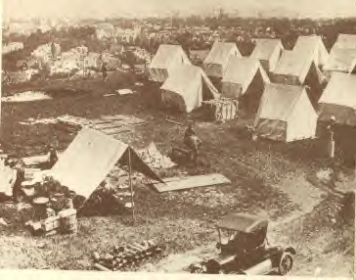
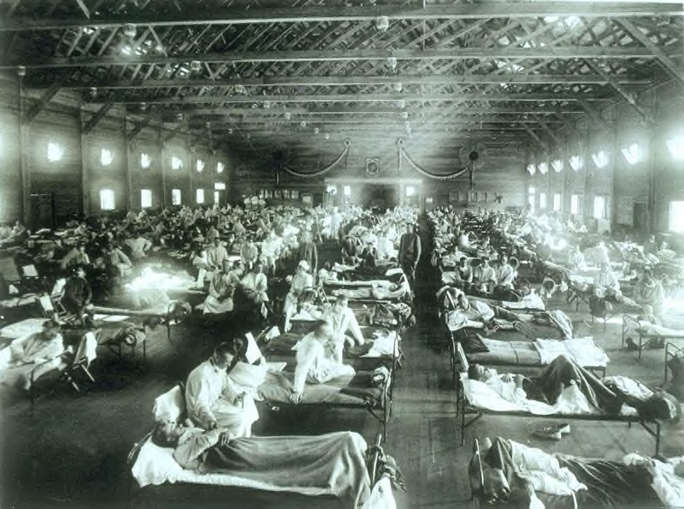
Influenza Pandemic of 1918
Emergency Tent Hospital
This disaster led to the creation of
the Center for Disease Control
(CDC). They hire scientists to
cure diseases.

Slide 26
The San Francisco Earthquake
April 18th 1906 San Francisco CA
Earthquake lasted only one minute
Fires broke out afterwards because of broken gas pipes and down electric wires
City burned for 3 days because of no water because all the water mains were broken
2/3 of San Francisco was destroyed…it was home to over 400,000 people

Slide 27
The San Francisco Earthquake

Slide 28
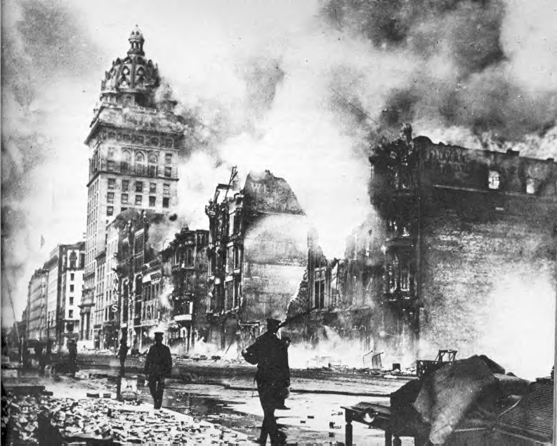
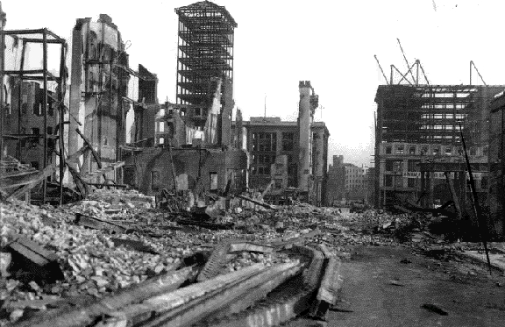
The San Francisco Earthquake

Slide 29
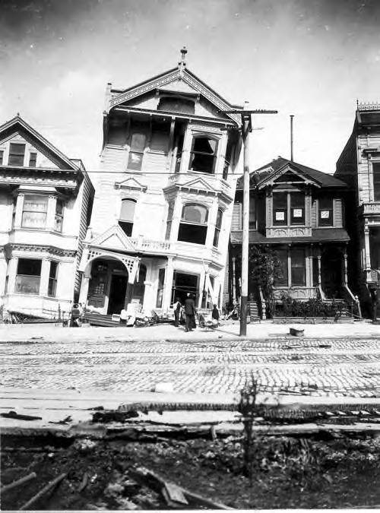
The San Francisco Earthquake
Now, California has some of
the strongest building codes
in the United States.

Slide 30
The Wisconsin Forest Fire
October 8, 1871 Peshtigo, Wisconsin
Lumber Mill Town
Cause: Piles of debris and tree roots were on fire
Destroyed entire town and killed over 800 people

Slide 31
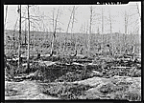
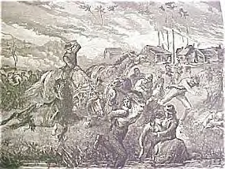
The Wisconsin Forest Fire

Slide 32
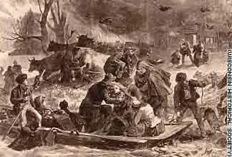
The Wisconsin Forest Fire

Slide 33
October 8th 1871 Another disaster is smoldering…
Not many people knew about the Wisconsin Forest Fire because of another event that night “stole” the headlines…

Slide 34
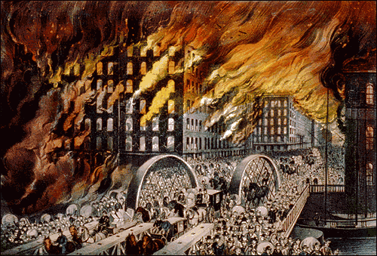
The Great Chicago Fire of 1871
In the middle of difficulty lies opportunity. Author: Albert Einstein

Slide 35
The Great Chicago Fire of 1871
We are going to read The Great Fire by Jim Murphy.
This was a great disaster, but it also showed the heroism and determination Americans had to survive and rebuild.
Every disaster always made our country safer by creating new safety laws…notice how many of the disasters were almost 100 years ago!

Slide 36
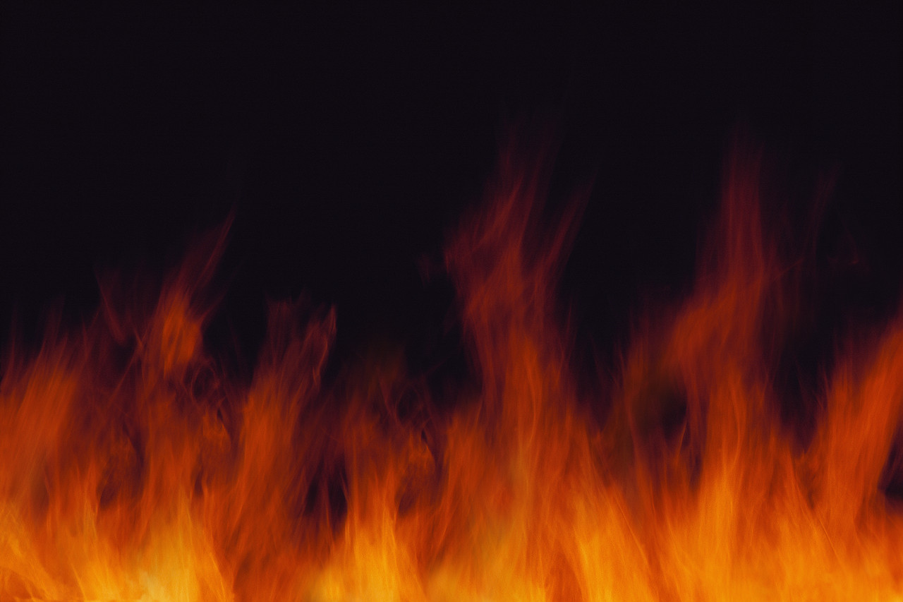
“A City Ready to Burn”
What do you think it means?
Does the title really mean fire?
What would make a city “ready” to burn?
Practice inferring and predicting

Slide 37
This powerpoint was kindly donated to www.worldofteaching.com
http://www.worldofteaching.com is home to over a thousand powerpoints submitted by teachers. This is a completely free site and requires no registration. Please visit and I hope it will help in your teaching.

